Slide 1

CSCI/ARTI 8950 Machine Learning
Lecture Notes 3: Decision Trees
Khaled Rasheed
Professor
School of Computing
Member
Institute for Artificial Intelligence
University of Georgia
Credit: some examples & figures by Marine Carpuat, Tom Mitchell and Guoping Qiu

Slide 2
Machine Learning
as Function Approximation
Problem setting
Set of possible instances 𝑋
Unknown target function 𝑓: 𝑋 → 𝑌
Set of function hypotheses 𝐻 = ℎ ℎ: 𝑋 → 𝑌}
Input
Training examples { 𝑥 ¹ , 𝑦 ¹
target function 𝑓
Output
, … 𝑥 ^{𝑁} , 𝑦 ^{𝑁} } of unknown
Hypothesis ℎ ∈ 𝐻 that best approximates target function 𝑓

Slide 3
Today: Decision Trees
What is a decision tree?
How to learn a decision tree from data?

Slide 4
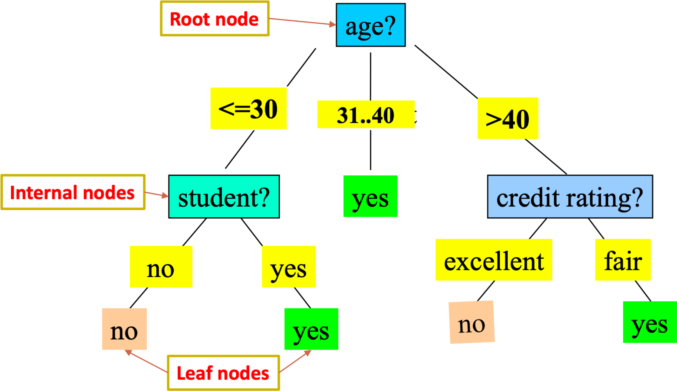
Tree-based Models
Use trees to partition the data into different regions and
make predictions
2

Slide 5
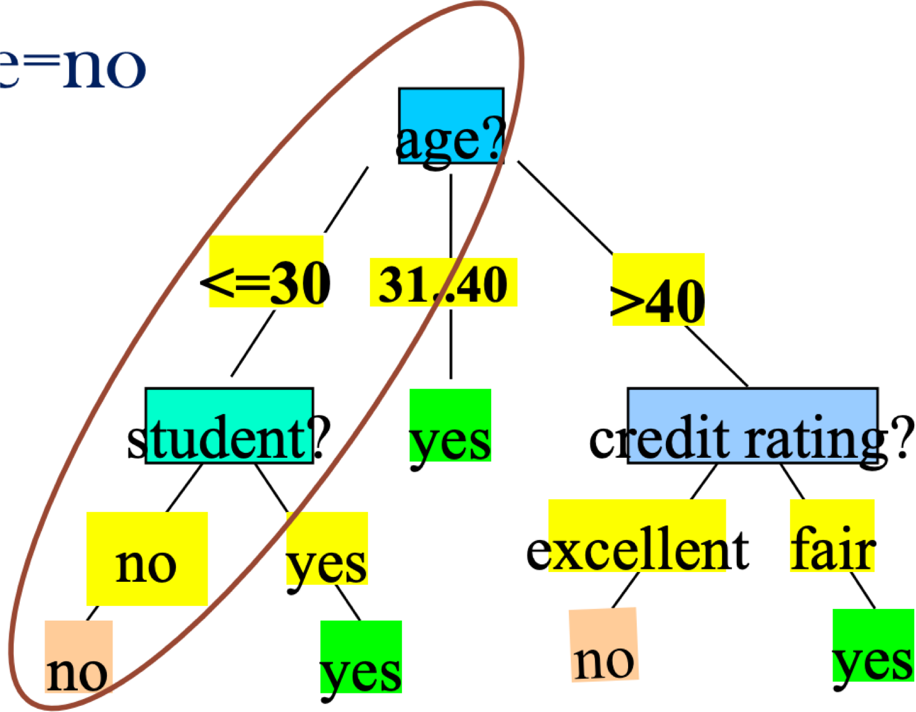
Easy to Interpret
A path from root to a leaf node corresponds to a rule
E.g., if age<=30 and student=no then target value=no
3

Slide 6
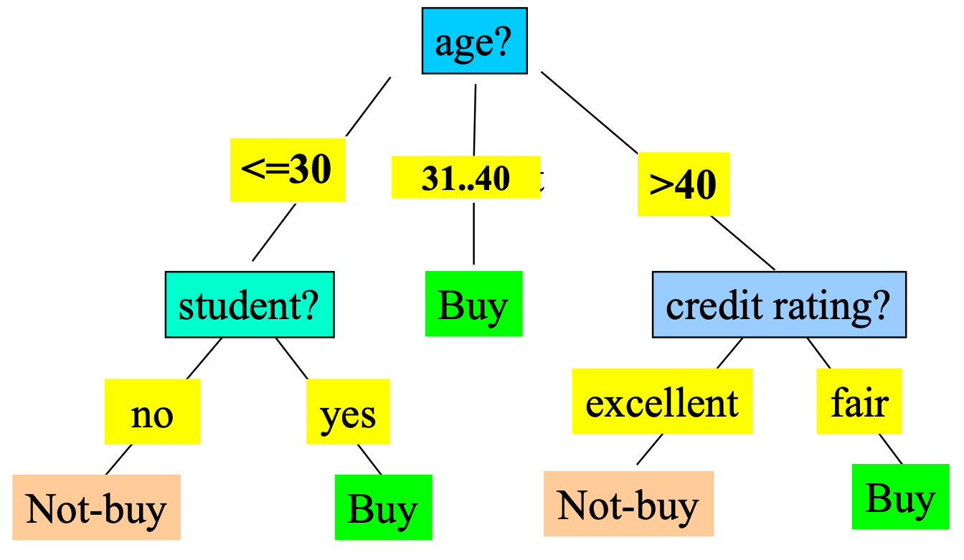
Decision Tree Induction
Decision tree construction:
A top-down, recursive, divide-and-conquer process
Resulting tree:
age | income | student | credit_rating | buys_computer
<=30 | high | no | fair | no
<=30 | high | no | excellent | no
31…40 | high | no | fair | yes
>40 | medium | no | fair | yes
>40 | low | yes | fair | yes
>40 | low | yes | excellent | no
31…40 | low | yes | excellent | yes
<=30 | medium | no | fair | no
<=30 | low | yes | fair | yes
>40 | medium | yes | fair | yes
<=30 | medium | yes | excellent | yes
31…40 | medium | no | excellent | yes
31…40 | high | yes | fair | yes
>40 | medium | no | excellent | no
Training data set: Who buys computer? ₄

Slide 7
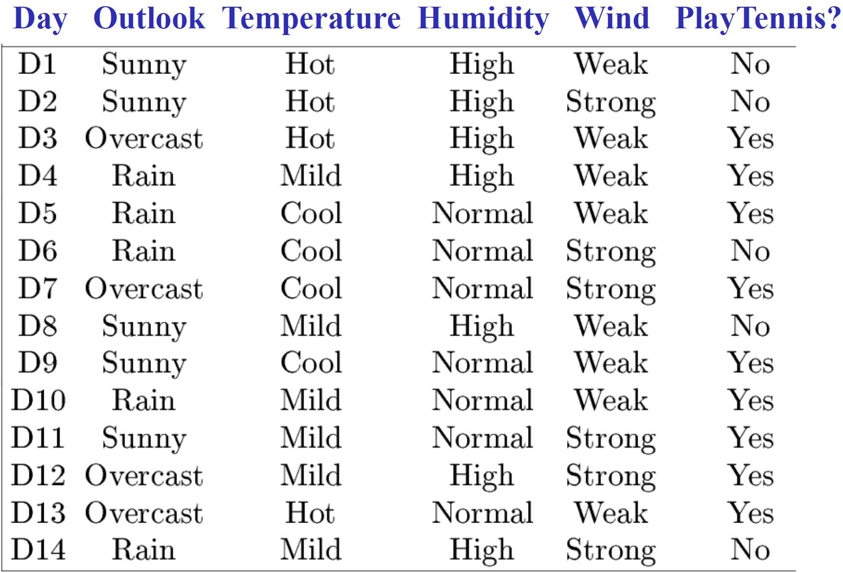
An example training set

Slide 8
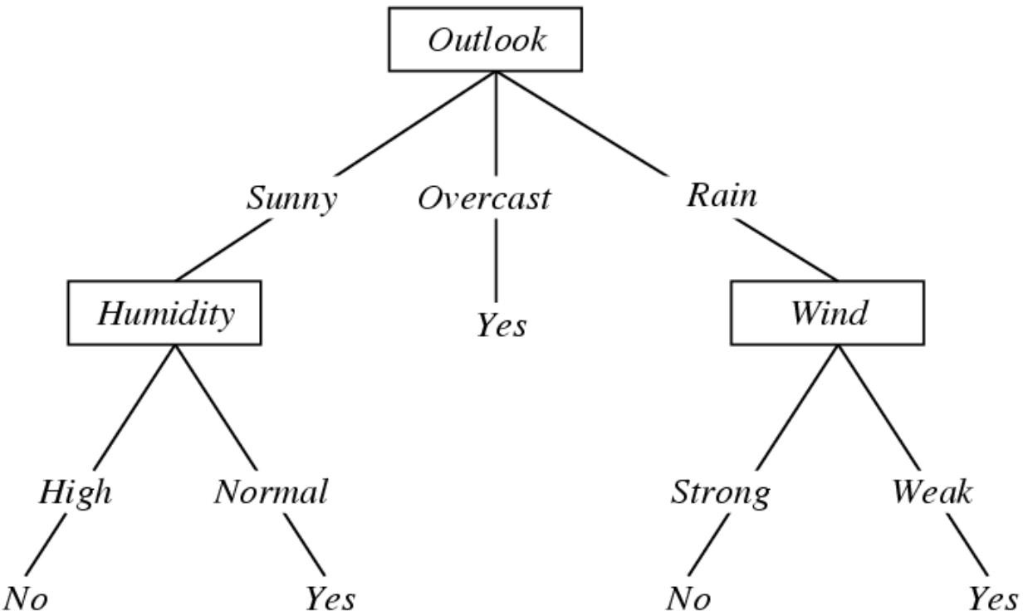
A decision tree
to decide whether to play tennis

Slide 9
Decision Trees
Representation
Each internal node tests a feature
Each branch corresponds to a feature value
Each leaf node assigns a classification
Decision trees represent functions that map examples in X to classes in Y

Slide 10
Exercise
How would you represent the following Boolean functions with decision trees?
AND
OR
XOR
– 𝐴 ∩ 𝐵 ∪ (𝐶 ∩ ¬𝐷)

Slide 11
When to use a Decision Tree?
Examples are represented by a small to moderate number of attributes
Each attribute conveys significant information
Not suitable for sensory data (e.g. Pixels of an image)
The label (class) must be discrete
Extensions for continuous prediction include Model Trees and Regression Trees

Slide 12
Today: Decision Trees
What is a decision tree?
How to learn a decision tree from data?

Slide 13
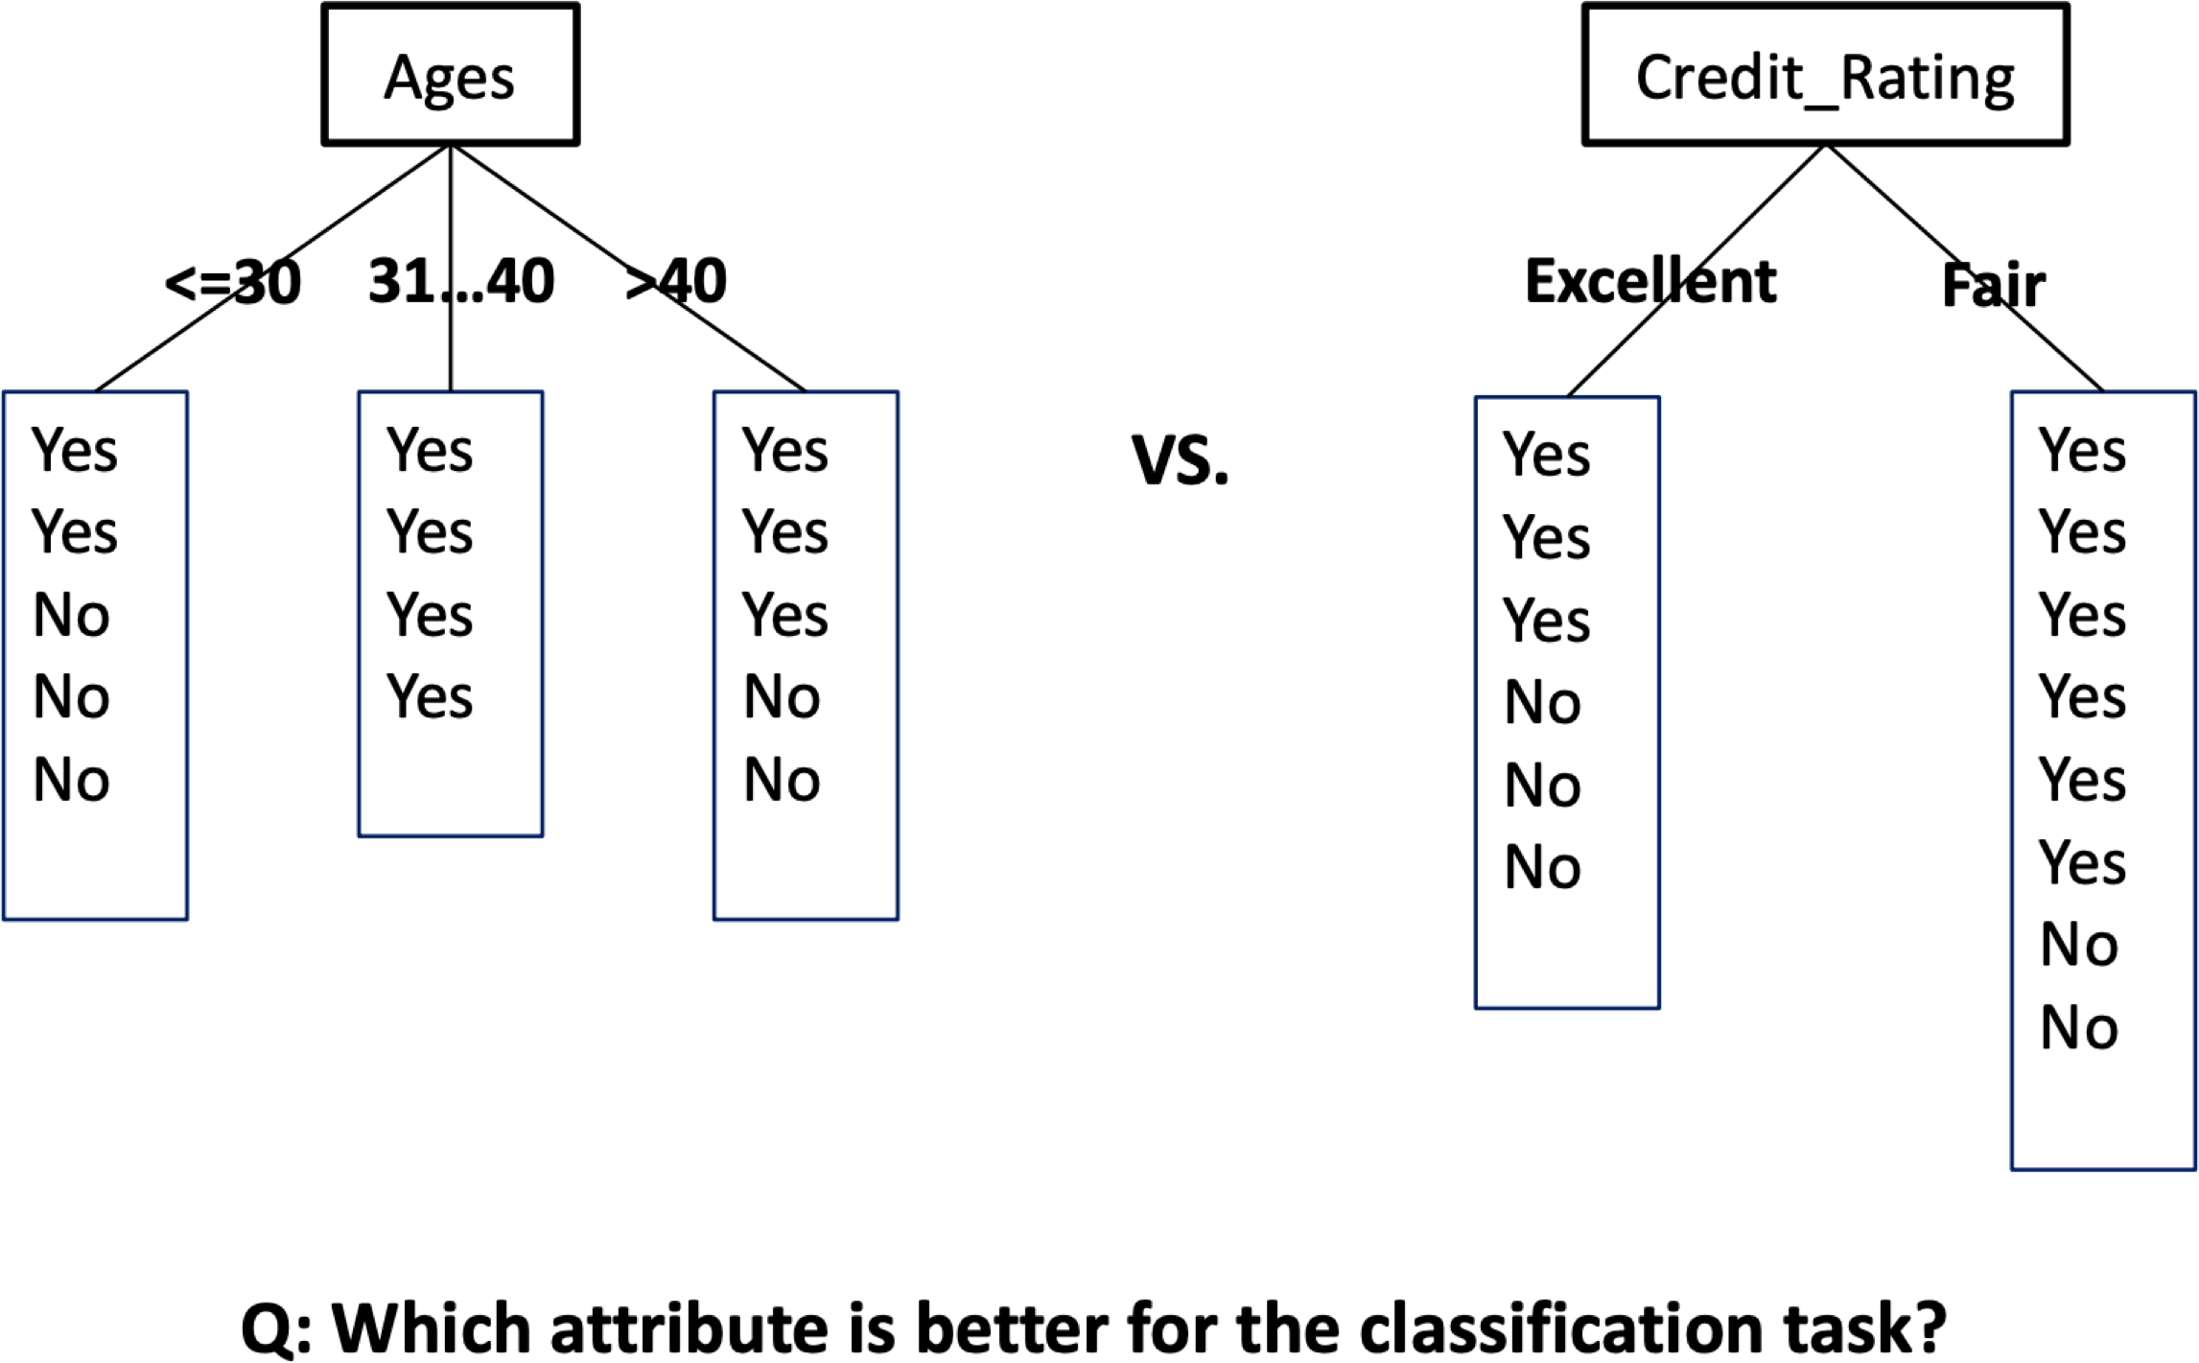
How to Choose Attribute?
5

Slide 14
Function Approximation with Decision Trees
Problem setting
Set of possible instances 𝑋
Each instance 𝑥 ∈ 𝑋 is a feature vector 𝑥 = [𝑥₁, … , 𝑥_{𝐷}]
Unknown target function 𝑓: 𝑋 → 𝑌
𝑌 is discrete valued
Set of function hypotheses 𝐻 =
– Each hypothesis ℎ is a decision tree
Input
ℎ ℎ: 𝑋 → 𝑌}
Training examples { 𝑥 ¹ , 𝑦 ¹
target function 𝑓
Output
, … 𝑥 ^{𝑁} , 𝑦 ^{𝑁} } of unknown
Hypothesis ℎ ∈ 𝐻 that best approximates target function 𝑓

Slide 15
Decision Tree Learning
Finding the hypothesis ℎ ∈ 𝐻
That minimizes training error
Or maximizes training accuracy
How?
𝐻 is too large for exhaustive search!
We will use a heuristic search algorithm
Pick questions to ask, in order
Such that classification accuracy is maximized

Slide 16
Top-down Induction of Decision Trees
CurrentNode = Root
DTtrain(examples for CurrentNode,features at CurrentNode):
Find F, the “best” decision feature for next node
For each value of F, create new descendant of node
Sort training examples to leaf nodes
If training examples perfectly classified at leaf
Stop
Else
Recursively apply DTtrain over new leaf nodes

Slide 17
How to select the “best” feature?
A good feature is a feature that lets us make correct classification decision
Criteria to measure how good a feature is
Classification accuracy
Information Gain (using entropy)
The GINI Index (used in CART, IBM IntelligentMiner)
https://www.slideshare.net/amrsb/decision-trees-for-machine-learning
– …
Let’s try some on the PlayTennis dataset

Slide 18
Let’s build a decision tree using features W, H, T

Slide 19
Partitioning examples according to Humidity feature

Slide 20
Partitioning examples: Humidity = High
Majority label=No, Error=3 if we make a leaf and stop

Slide 21
Partitioning examples: Humidity = Normal
Majority label=Yes, Error=1 if we make a leaf and stop

Slide 22
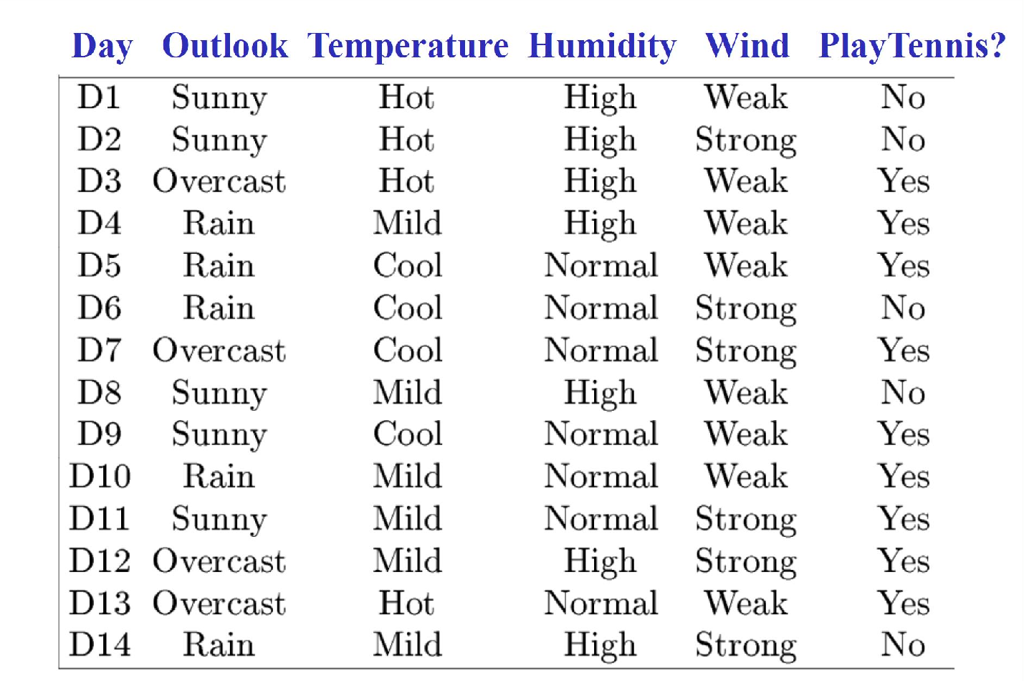
Can we do better?
H = Normal and W = Strong

Slide 23
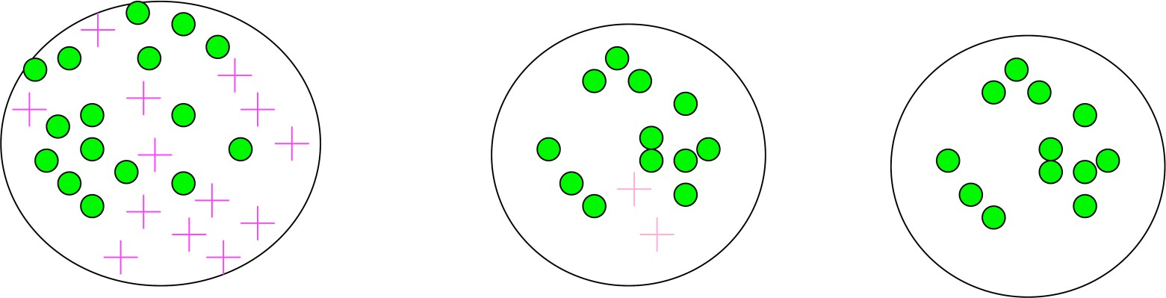
Another feature selection criterion: Entropy
Used in the ID3 algorithm [Quinlan]
– pick feature with smallest entropy to split the examples at current iteration
Entropy measures impurity of a sample of examples

Slide 24
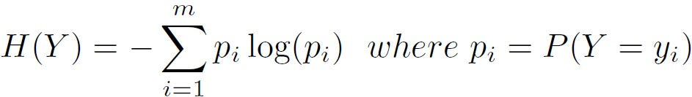
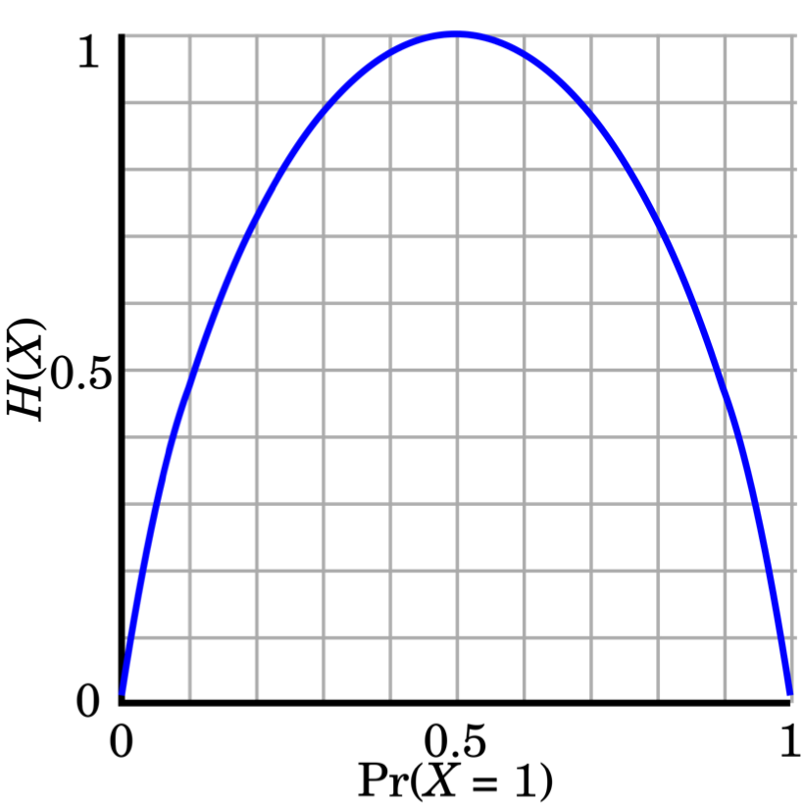

Entropy
Entropy (Information Theory)
A measure of uncertainty associated with a random number
Calculation: For a discrete random variable Y taking m
distinct values {y₁, y₂, …, y_{m}}
Interpretation
Higher entropy → higher uncertainty
Lower entropy → lower uncertainty
Conditional entropy
m = 2
6

Slide 25
Information Gain
Select the attribute with the highest information gain (used in
classical algorithms: ID3/C4.5/C5)
Let p_{i} be the probability that an arbitrary tuple in D belongs to class C_{i} estimated by |C_{i}, D| / |D|
Expected information (entropy) needed to classify a tuple in D:
Info(D) = −∑ p_{i} log₂ ( p_{i} )
i=1
Information needed (after using A to split D into v partitions) to
classify D :
m
v
| D |
Info (D) =
∑
j
Info(D )
A
| D |
j
j =1
Information gained by branching on attribute A
Gain(A) = Info(D)− Info_{A}(D)
7

Slide 26
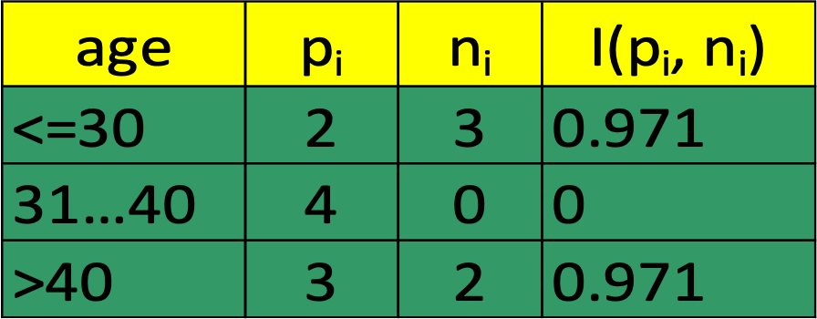
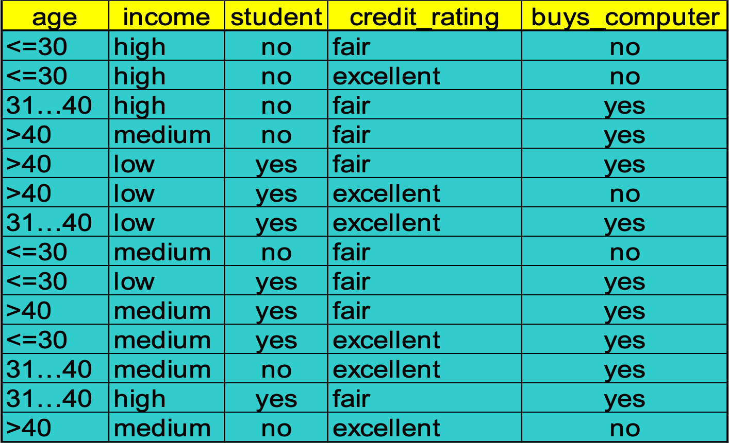
Information Gain: Example
Class P: buys_computer = “yes”
Class N: buys_computer = “no”
Step 1: Calculate Info(D)
Info(D) = I (9,5) = − ⁹ log ( ⁹ ) − ⁵ log ( ⁵ ) =0.940
2 2
14 14 14 14
Step 2: Calculate Info_{A}(D) for each feature A
Info (D) = ⁵ I (2,3) + ⁴ I (4,0)
age
14 14
+ ⁵ I (3,2) = 0.694
14
^{5 I (2,3)} means “age <=30” has 5 out of 14
¹⁴samples, with 2 yes’s and 3 no’s. Hence
Gain(age) = Info(D) − Info_{age} (D) = 0.246
Similarly,
Gain(income) = 0.029 Gain(student) = 0.151 Gain(credit _ rating) = 0.048
Step 3: Choose the feature with highest Gain
(e.g., age in this example)
8

Slide 27
Continuous Attributes
Real-valued attributes can, in advance, be discretized into
ranges, such as big, medium, small
Alternatively, one can develop splitting nodes based on thresholds
of the form A < c that partition the data into examples that
satisfy A < c and A >= c. The information gain for these splits
is calculated in the same way and compared to the information
gain of discrete splits.
How to find the split with the highest gain ?
For each continuous feature A:
Sort examples according to the value of A
For each ordered pair (x, y) with different labels
Check the mid-point as a possible threshold. i.e,
S_{a <=x}, S_{a >=y}

Slide 28
Continuous Attributes
Example:
Temperature (T): 40 50 60 70 76 80 90
Class: - - + - + + -
Use the threshold with the highest information gain
Check thresholds: T < 55 or T < 65 or T<73 or T < 85

Slide 29
Missing Values with Decision Trees
Diagnosis = < temperature, blood_pressure,…, blood_test=?,…>
Many times values are not available for some attributes
during training or testing (e.g., medical diagnosis)
Training: evaluate Gain(S,a) where in some of the examples
a value for a is not given
Day Outlook Temperature Humidity Wind PlayTennis
1 Sunny Hot High Weak No
2 Sunny Hot High Strong No
8 Sunny Mild ??? Weak No
9 Sunny Cool Normal Weak Yes
11 Sunny Mild Normal Strong Yes

Slide 30
Missing Values At Training
Day Outlook Temperature Humidity Wind PlayTennis 8 Sunny Mild ??? Weak No
Outlook
Use:
Sunny
Overcast
Rain
1,2,8,9,11
3,7,12,13
4,5,6,10,14
A) the most common Humidity at Sunny
B) as (A) but with PlayTennis = No (useless in testing)
C) Fractional instances
2+,3-
4+,0-
3+,2-
?
Yes
?

Slide 31
Missing Values
Diagnosis = < temperature, blood_pressure,…, blood_test=?,…>
Many times values are not available for all attributes
during training or testing (e.g., medical diagnosis)
Training: evaluate Gain(S,a) where in some of the examples
a value for a is not given
Testing: classify an example without knowing the value of a

Slide 32
Missing Values At Testing
Outlook = ???, Temp = Hot, Humidity = Normal, Wind = Strong, label = ??
Outlook
A) use most common value in training
B) Blend by labels:
5/14 Yes + 4/14 Yes +5/14 No = Yes
Blend by probability (estimated by counts)
Sunny
Overcast
Rain
1,2,8,9,11
3,7,12,13
4,5,6,10,14
2+,3-
4+,0-
3+,2-
Humidity
Yes
Wind
High
Normal
Strong
Weak
No
Yes
No
Yes

Slide 33
Other Issues
Attributes with different costs
-Solution: Change information gain so that low cost attributes are preferred
Alternative measures for selecting attributes
When different attributes have different number of values
information gain tends to prefer those with many values (e.g. Date)
They do not generalize well
-Solution: Use GainRatio

Slide 34
A decision tree to distinguish homes in New York from homes in San Francisco
http://www.r2d3.us/visual-intro-to-machine-learning-part-1/

Slide 35
Summary: Decision Trees
What is a decision tree?
How to learn a decision tree from data?
Top-down induction to minimize classification error
Choose features using Information Gain
Continuous Attributes
Missing Values

